Slide 1


Mystic Mart Stock Management System
BY
Lalit Patel
0101CA221030

Slide 2

Mystic Mart Stock Management System
A comprehensive desktop application for efficient shop management, focused on barcode generation and streamlining operations.

Slide 3


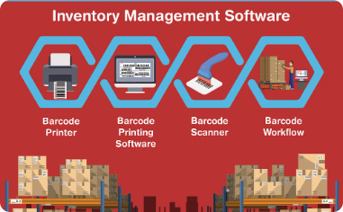
About the Desktop Application
Comprehensive Shop Management
Intuitive User Experience
Barcode Generation Capabilities
With a clean and intuitive user interface, Mystic Mart empowers shop owners to efficiently manage their business with minimal technical expertise.
Mystic Mart is a powerful desktop application designed to streamline all aspects of shop management, from inventory tracking to sales reporting.
A key feature of Mystic Mart is its ability to generate barcodes for products, streamlining the checkout process and enabling accurate inventory management.

Slide 4
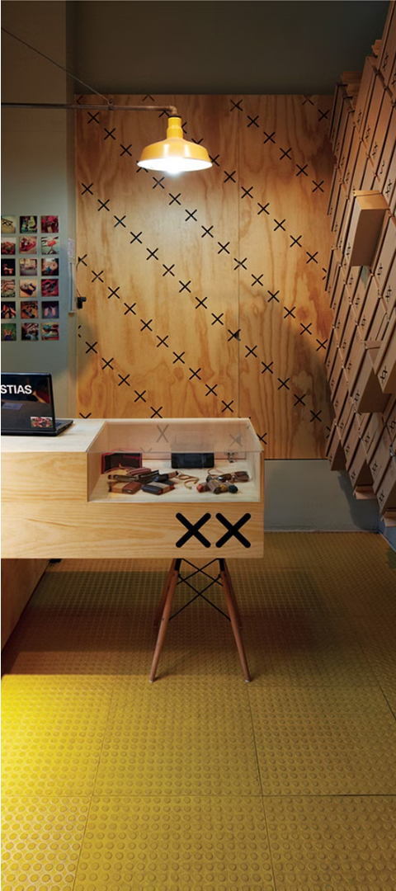
Customizable for Any Store
Flexible Design
Scalable Functionality
Mystic Mart's intuitive interface can be tailored to the unique needs and branding of any retail store, ensuring a seamless fit with your business.
The software easily adapts to handle the inventory management requirements of small shops, large supermarkets, and everything in between.
Streamlined Integration
Mystic Mart integrates smoothly with your existing systems, minimizing disruption and maximizing efficiency across your entire operation.

Slide 5
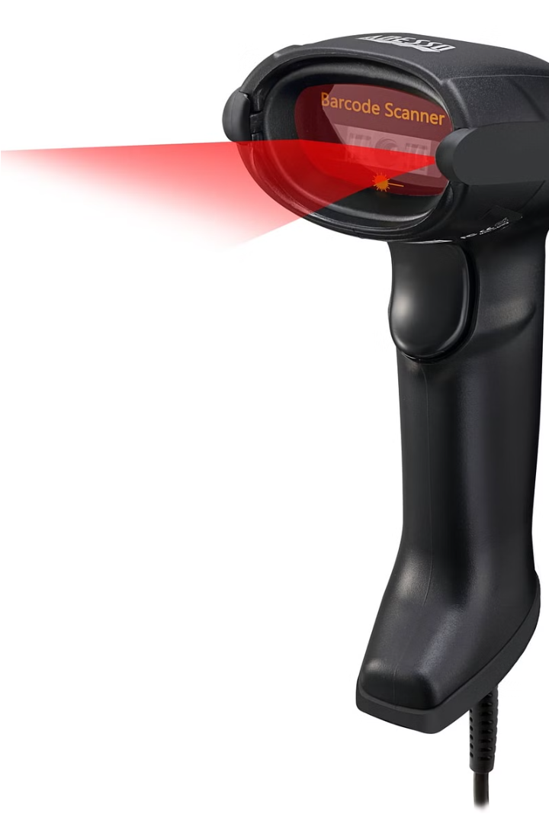
Barcode Generation for Products
Mystic Mart's robust barcode generation feature enables merchants to seamlessly create unique barcodes for each product in their inventory. This streamlines the checkout process, improves inventory tracking, and reduces the risk of human error.
With just a few clicks, store owners can generate high-quality barcodes that can be easily printed and affixed to products. This integration ensures a fast and frictionless shopping experience for customers.

Slide 6
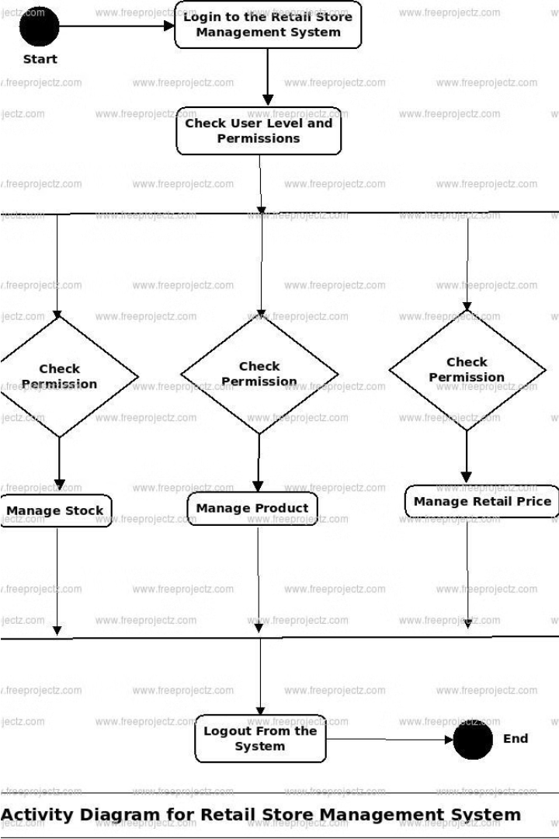
Reasons for Developing Mystic Mart
The Mystic Mart Stock Management System was developed to address the pain points of traditional shop management, offering a comprehensive solution to streamline operations and enhance efficiency.

Slide 7
Reduction in Manual Efforts
Streamlined Workflows
Increased Efficiency
Mystic Mart automates many time-consuming manual tasks, allowing store owners to focus on high-value activities and improve overall productivity.
By eliminating the need for repetitive data entry and paperwork, Mystic Mart significantly reduces the risk of human error and ensures accurate inventory tracking.

Slide 8



Error-Free Bill Generation
Accurate Billing
Automated Totals
Integrated Inventory
Mystic Mart's advanced billing system ensures error-free invoices, eliminating the need for manual checking and reducing costly mistakes.
The software automatically calculates totals, taxes, and discounts, providing customers with clear, professional-looking receipts every time.
By linking inventory data directly to the billing system, Mystic Mart ensures that all item details are accurately reflected on customer invoices.

Slide 9

Zero Paperwork
Efficient Data Management
Environmental Benefits
Simplified Reporting
All key reports and analytics are generated automatically, saving time and resources compared to traditional manual record-keeping.
Mystic Mart eliminates the need for physical paperwork, streamlining inventory and sales data into a digital format for easy access and organization.
By going paperless, Mystic Mart contributes to a more sustainable business model, reducing waste and promoting eco-friendly practices.

Slide 10
Key Features of Mystic Mart
Barcode Generation
Invoice Management
Inventory Tracking
Reporting & Analytics
Easily generate barcodes for your products with Mystic Mart's built-in barcode creation tool. Streamline your inventory tracking and checkout processes.
Quickly generate professional-looking invoices with customizable templates. Track sales, manage customer information, and export data for tax purposes.
Keep a close eye on your stock levels with Mystic Mart's real-time inventory management system. Get alerts when items are running low and make informed restocking decisions.
Gain valuable insights into your business with comprehensive reporting and analytics. Track sales trends, identify top-selling products, and make data-driven decisions.

Slide 11
Technology Used for Mystic Mart
Graphical User Interface
Database Management
Integrated Development
Backend Codebase
Mystic Mart's user interface was developed using the powerful Java Swing and Java AWT frameworks, providing a sleek and responsive visual experience for the application.
The team selected Oracle as the database management system to securely store and efficiently manage all of Mystic Mart's business data and inventory information.
The Mystic Mart project was built using NetBeans 8.2 IDE, an industry-leading development environment that streamlined the coding process and enabled seamless integration of all application components.
Mystic Mart's robust backend was implemented entirely in Java, ensuring a reliable and high-performing core that powers the application's key functionalities.

Slide 12



Future Scope
Scalability
1
Expand to accommodate more features and larger databases
Integration
2
Integrate with other business systems like CRM and ERP
Cloud Support
3
Move the system to the cloud for better accessibility and scalability
The Mystic Mart stock management system is designed with future growth in mind. Its scalable architecture allows for the addition of more features and the ability to handle larger databases as the business expands. Additionally, the system has the potential to integrate with other critical business tools, such as CRM and ERP platforms, creating a more comprehensive and streamlined operational ecosystem. Finally, the team is exploring the option of migrating the system to the cloud, which would provide enhanced accessibility and improved scalability to meet the evolving needs of the organization.

Slide 13
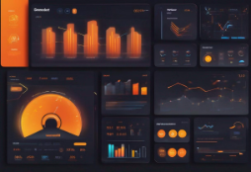
Integrating AI/ML
Predictive Analytics
Customer Insights
Automated Restocking
Leverage AI and machine learning to forecast sales trends and predict stock requirements, enabling proactive inventory management.
Analyze customer behavior and purchase patterns to improve service quality and tailor product offerings to better meet their needs.
Use AI-powered algorithms to automatically monitor and restock inventory based on real-time sales data, ensuring optimal stock levels.

Slide 14
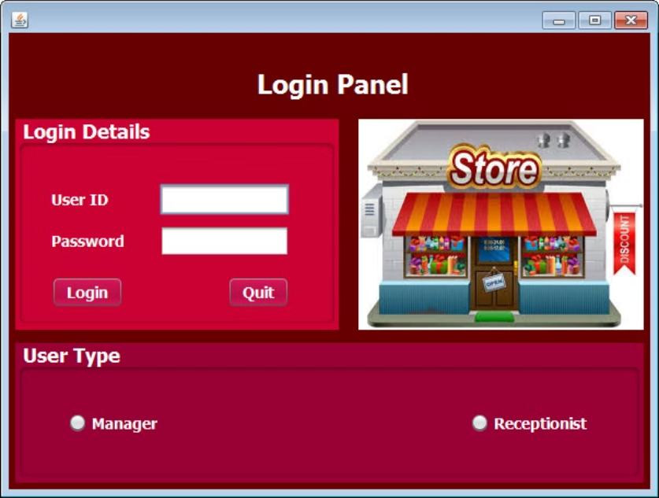

Slide 15
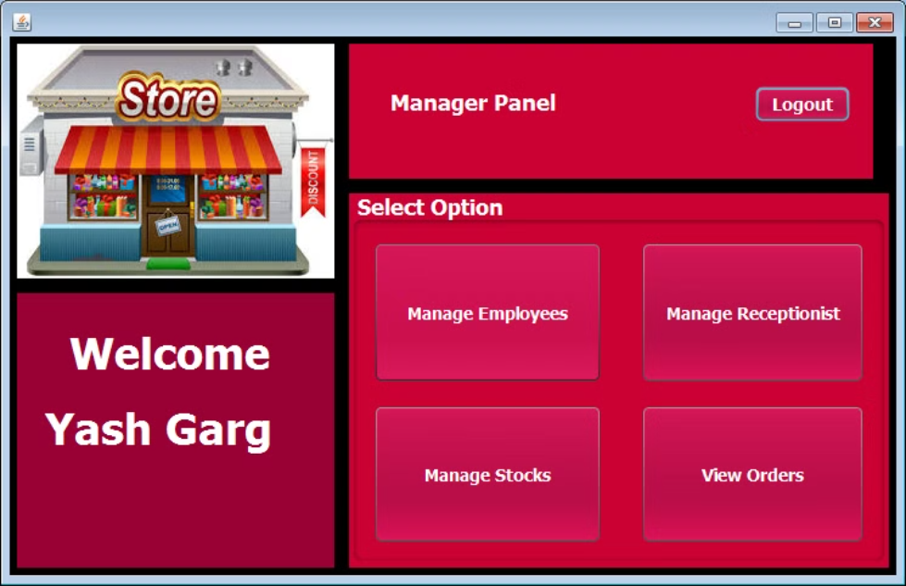

Slide 16
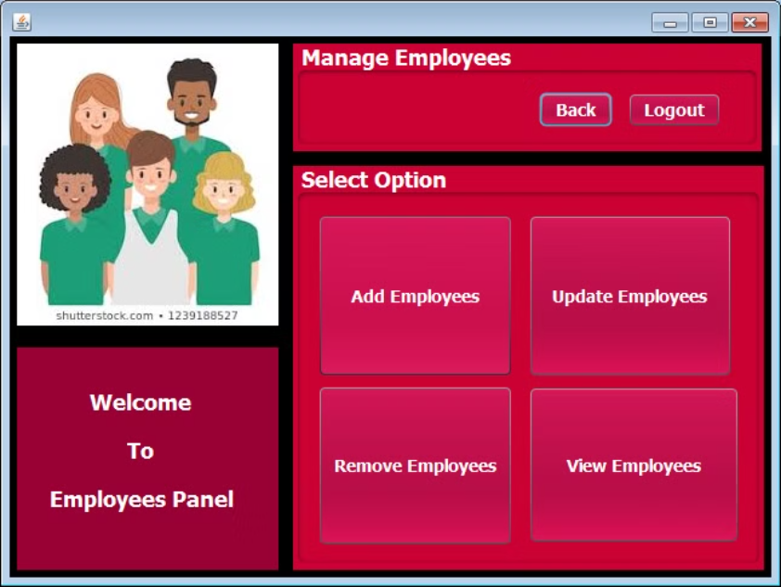

Slide 17
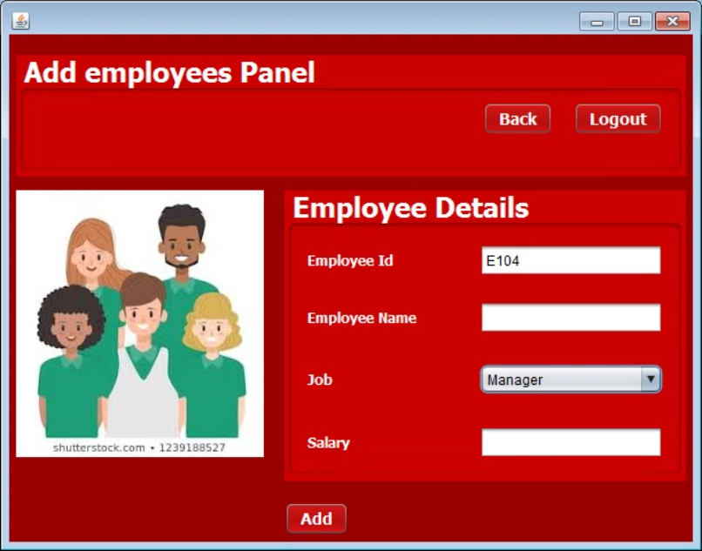

Slide 18
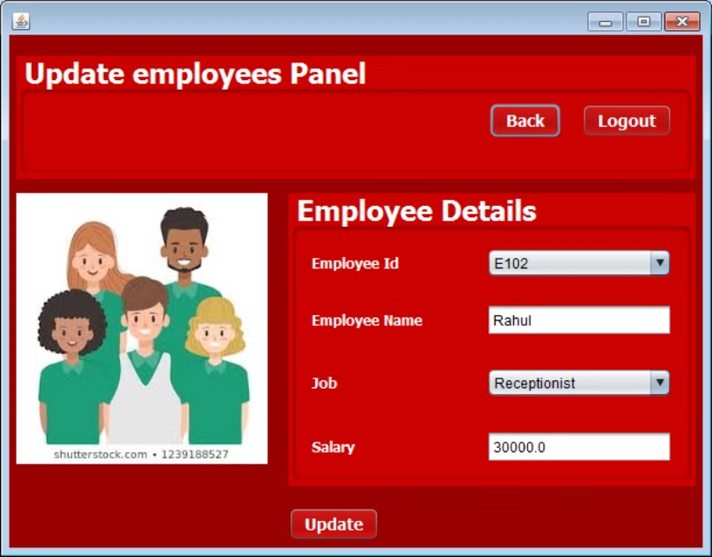

Slide 19


Slide 20
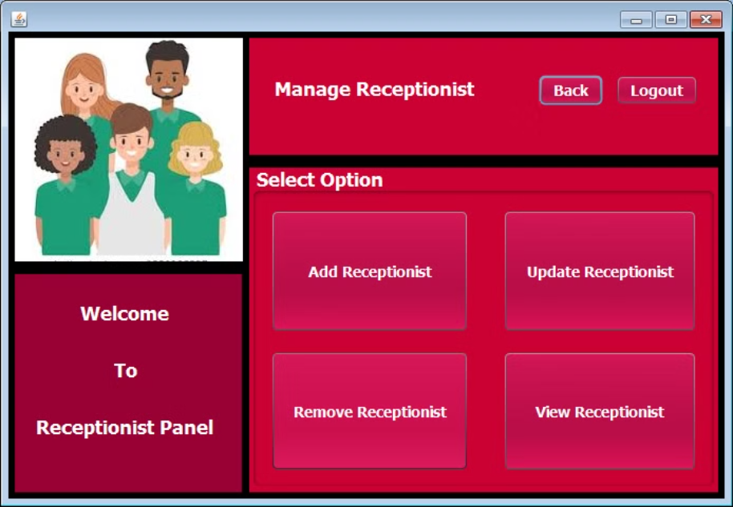

Slide 21
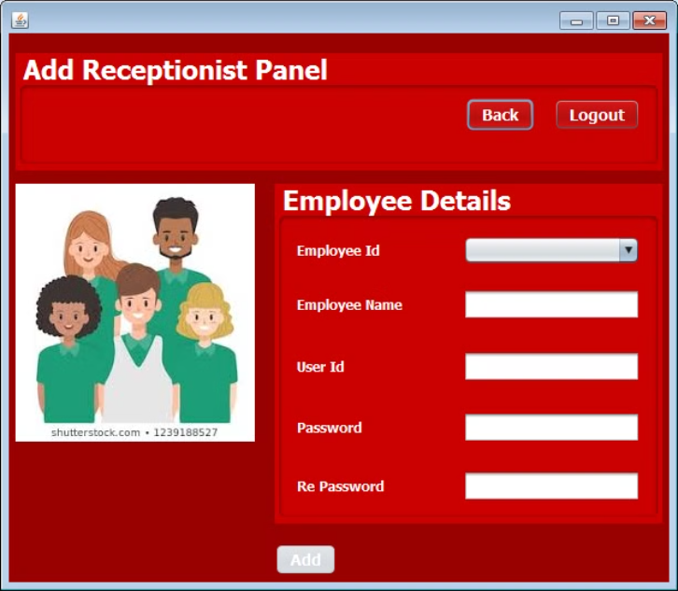

Slide 22
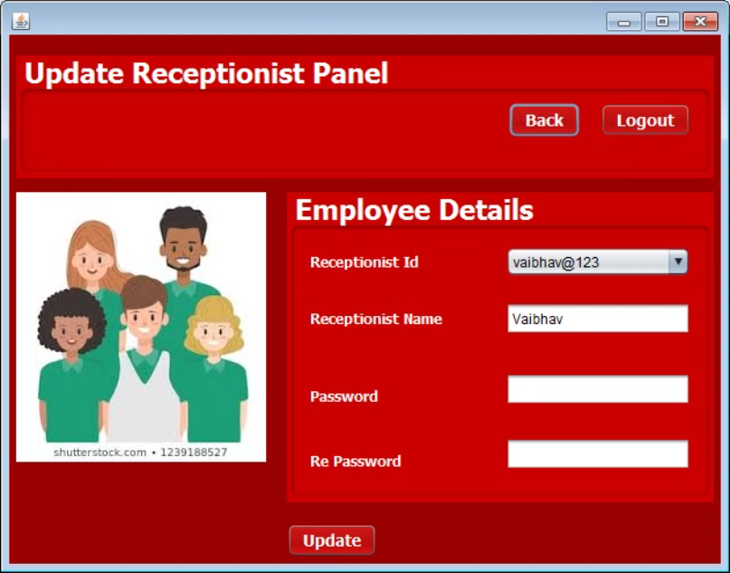

Slide 23
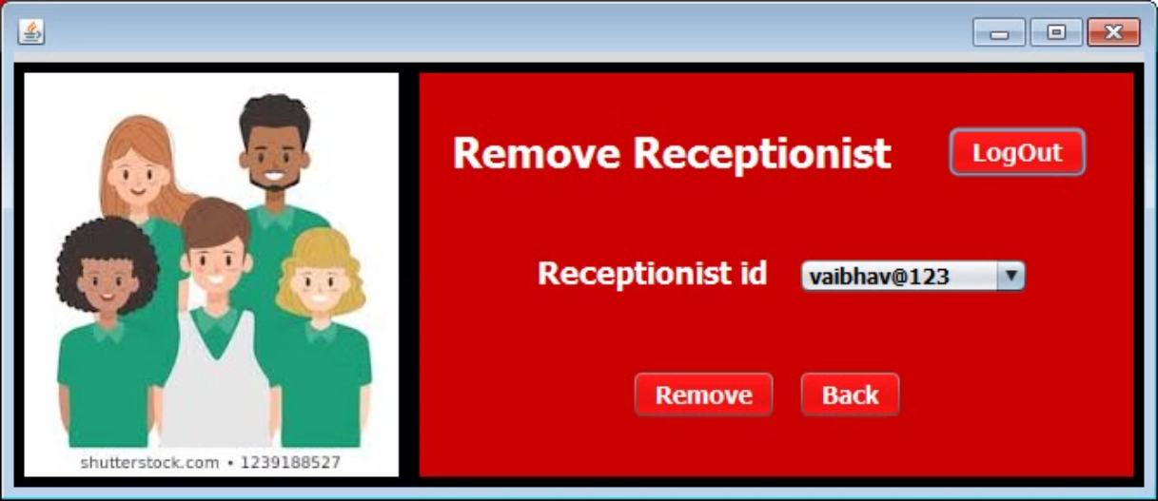

Slide 24
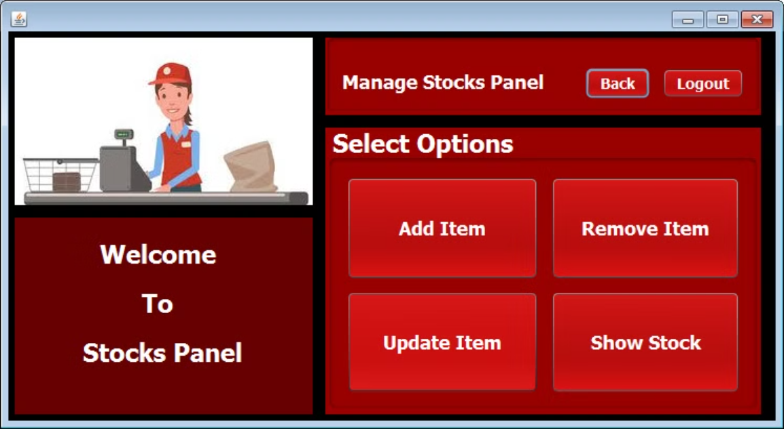

Slide 25

Conclusion
Mystic Mart is a powerful store management tool that offers significant improvements in efficiency and accuracy. Future enhancements with AI and machine learning can further revolutionize store operations and customer satisfaction.

